Slide 1
Multilayer Perceptron (MLP)

Slide 2
What is MLP
An MLP has at least one hidden layer apart from the input and output layer
It is a feedforward network with no feedback mechanism
Its activation function at the hidden layer neurons needs to be other than a step function
The network trains itself through a technique called backpropagation of error
This network can easily map nonlinearity in the data and hence more versatile
It can also be used as a universal function approximator

Slide 3
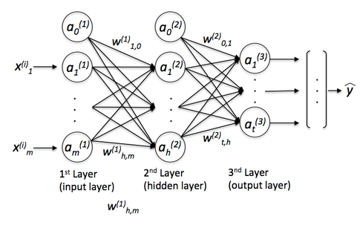
MLP Structure
Hidden layer neurons act as feature detectors
Neurons in hidden layer does feature space mapping using nonlinear transformation of input space
In normal cases, neurons in each layer don’t interact with each other but neurons from different layers are fully connected

Slide 4
Learning Process
Learning process of MLP rests entirely on the choice of activation function and optimization process
Backpropagation of error needs the activation function to be differentiable at every point
Step function is a bad choice for MLP
For single layer MLP (one hidden layer) usually two activation functions are used
Sigmoid function
Hyperbolic Tangent function

Slide 5
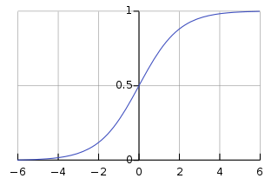
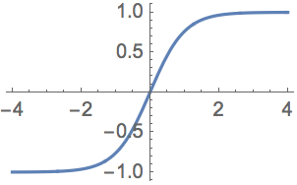
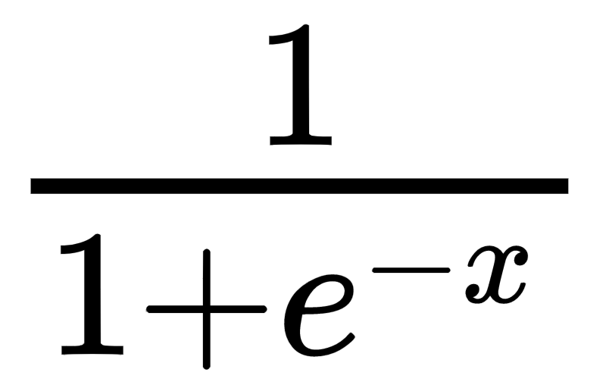
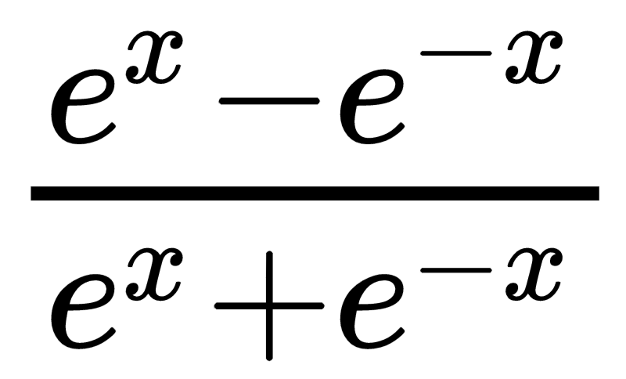
Learning Process (contd..)
Sigmoid function
Hyperbolic tangent function
Value lies between 0 and 1
Value lies between -1 and 1

Slide 6
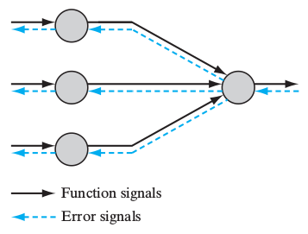
Learning Process (contd..)
MLP learning process takes place in two steps:
Feedforward of input signals
Backward propagation of error signals
Weight updation occurs during backpropagation of errors
Weight updation can take place in two ways:
Batch learning
Online learning

Slide 7
Learning Process (contd..)
Batch Learning:
Weight updation occurs after the entire training sample is fed through the network (called one epoch)
Adjustments of weights are made epoch-by-epoch basis
Accurate estimation of gradient vector (while using gradient descent method)
Parallelization of process is easy
Demanding in terms of storage
Not very effective in tracking small changes in data

Slide 8
Learning Process (contd..)
Online Learning
Weight updation occurs example-by-example basis
Quite simple to implement
Training samples are randomly shuffled at the end of each epoch which generate stochastic nature in learning which is less likely to get stuck into local minima as in case of batch learning
Not quite suitable for parallelization
Don’t get affected by data redundancy
Can explore complex patterns in nonstationary data

Slide 9
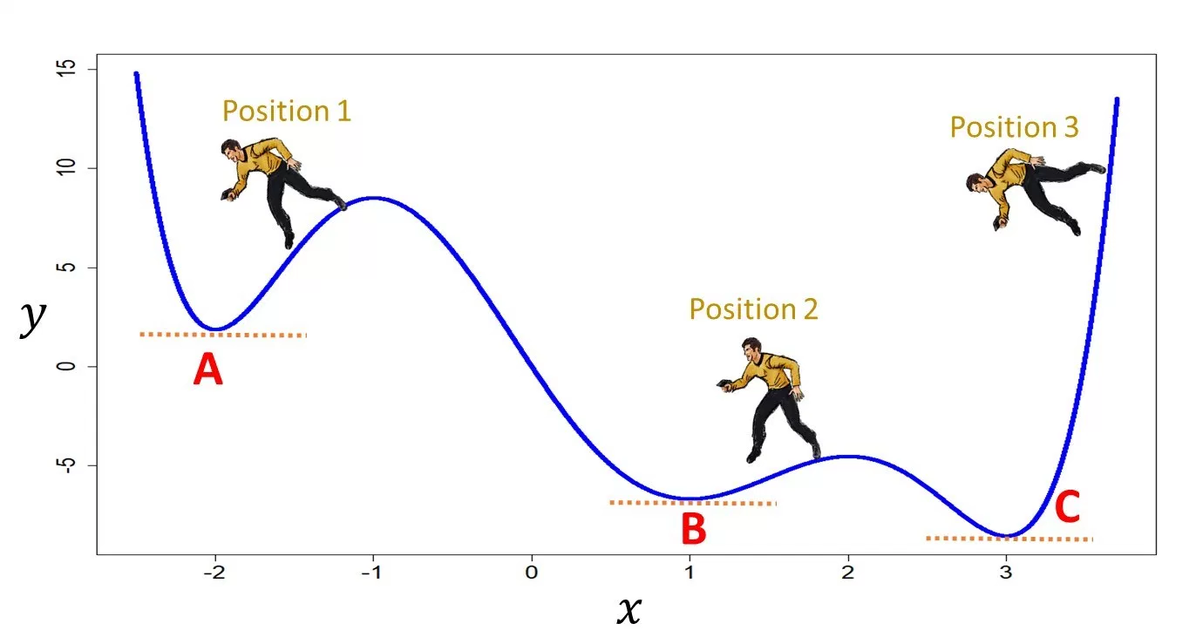
Understanding gradient descent
The algorithm tries to reach the lowest point of a function (could be a line or a surface) as quickly as possible
It needs a starting point to start with
Gradient of the function is found out at that point to find out along which direction the local minima can be found
The new value is calculated based on the gradient calculation

Slide 10

Understanding gradient descent (contd..)
Mathematically gradient descent is expressed as
η is called the learning rate
f(θ) is the function for which minima is to be found
θ is the parameter set for which the function will attain minima
⛛ is the gradient calculating operator

Slide 11
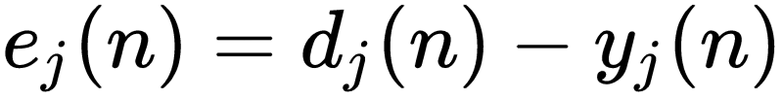
Error and Error function
In MLP, error is calculated only at the output nodes
Since, error can be both positive as well as negative, square error is taken into consideration
Since y_{j} is a function of all the weights existing in the MLP, error is also a function of all the synaptic weights
Error at the j^{th} output node
Desired output at j^{th} output node
Output of j^{th} output node

Slide 12
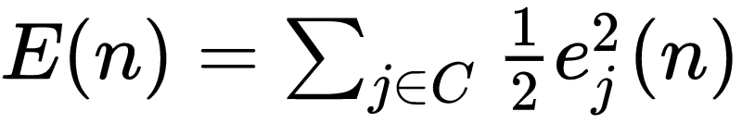

Error and Error function (contd..)
Total error is calculated as
where C includes all the neurons at the output layer. ½ is added for mathematical convenience
If there are N samples available, average error averaged over all the N samples is

Slide 13
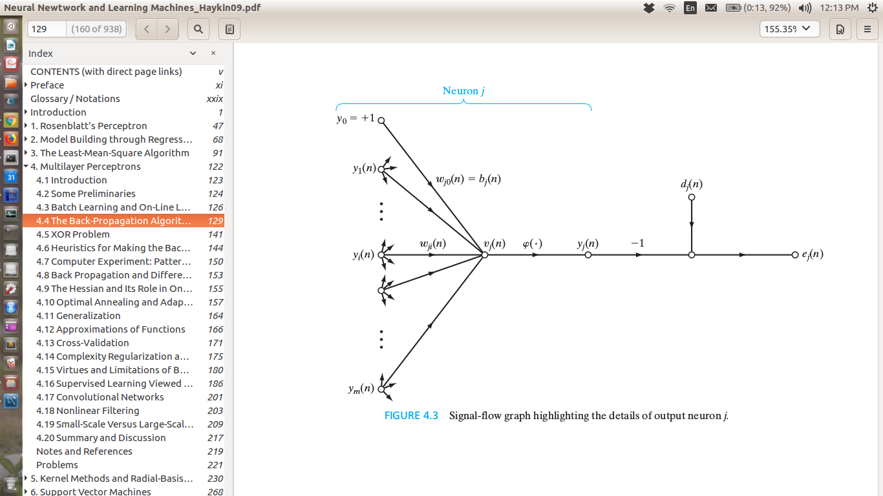
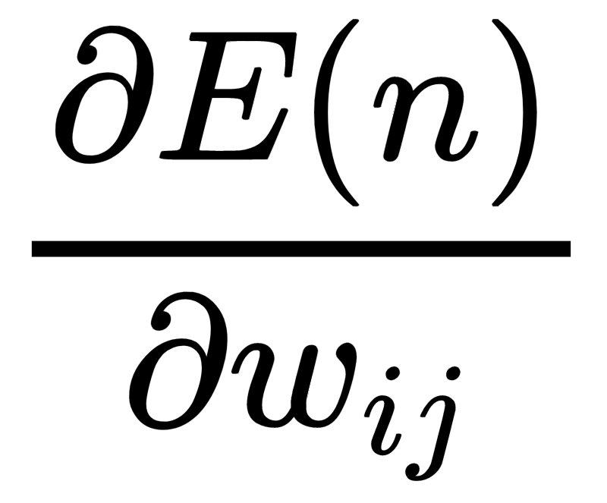
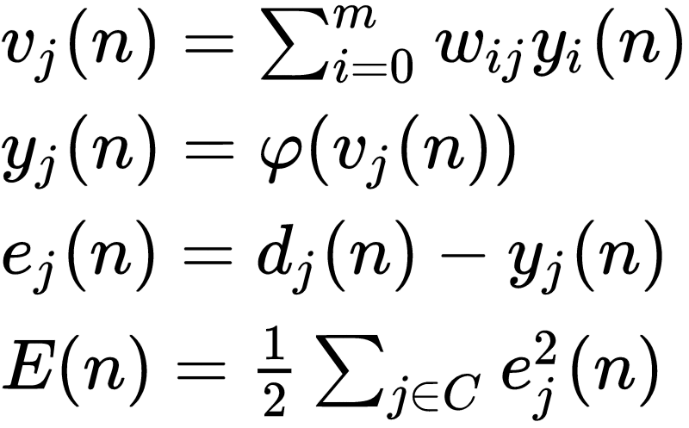
Understanding weight update
Error is a function of weights
For updating weights, error function needs to be partially differentiated w.r.t the weights
That is we need to find

Slide 14
Simple MLP (1 hidden layer and 1 hidden node)
d_{k}(n)
x₀
x₁
x₂
V_{j}(n)
y_{j}(n)
V_{k}(n)
y_{k}(n)
e_{k}(n)
w_{ij}(n)
𝜙(.)
w_{jk}(n)
𝜙₁(.)
x₃
tanh
sigmoid
ReLu
Elu etc
softmax
linear
sigmoid (sometimes)
x_{m}

Slide 15
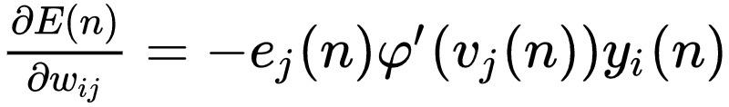
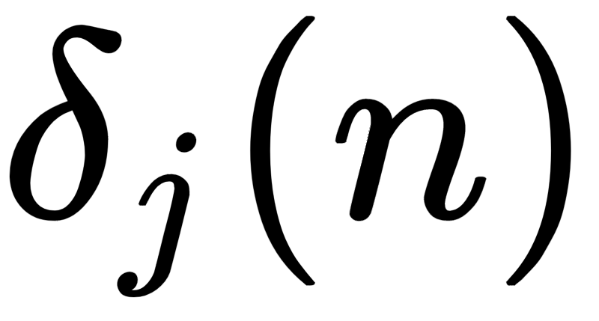
Understanding weight update (contd..)
The expression for partial differentiation can be found to be
Partial diff. of v_{j}(n) w.r.t to w_{ij}
Error
Input to neuron j
Local Gradient

Slide 16
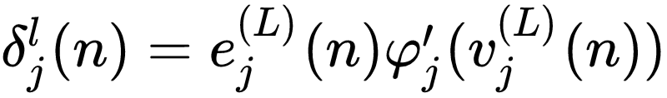
Understanding weight update (contd..)
If j^{th} neuron is lying in the output layer, calculation is quite simple because both predicted value and desired values would be available at the output node
If the j^{th} neuron is lying in one of the hidden layer, there will be no desired output and hence a complicated expression appears for local gradient
Neuron j is lying in the output layer L
Neuron j is in hidden layer l

Slide 17

Understanding weight update (contd..)
Weights are updated based on the following equation
Sometimes a momentum term is also added for faster convergence

Slide 18
Learning Parameter
Learning parameter η is important in convergence
High value will keep the weights oscillating (or even diverge)
Very small value will take lots of time for the weights to get optimized

Slide 19
Building and Training MLP
Sequential mode of back propagation is beneficial when dataset is large and there is data redundancy
Target values are to be chosen in the range of the output value of sigmoid function for faster convergence
Scaling of input vectors is good for ANN training
Weight initialization can be done randomly but better result can be got using uniform distribution having zero mean and variance equal to square root of total number of synaptic weights

Slide 20
Building and Training MLP
Learning can create considerable amount of problems if set arbitrarily any figure
Learning rate for input layer should be more than learning rate of output layer
Learning should be low with datasets having many inputs
Learning rate should be in the higher range in the dataset is having lower number of inputs
It is better to keep learning rate small

